Slide 1

Team jBehaving
Ashley Finger, Bai Xiong, Cody Lanier,
Cody Prior, Daniel Gallegos, Michel Watson

Slide 2
Got Track Days, Inc.
Juan Calderon
Sac State Alum
Car & Track Day Enthusiast
What is a Track Day?
Bring personal vehicle to the racetrack
Raceways sell days, not time
Companies resale individual tickets
Business Model
Sell Track Day tickets
Host Track Day Events
Provide Best Value and Customer Service
Juan’s experiences

Slide 3
Sponsor’s Need
The sponsor currently has to seek out potential customers himself via online message boards.
Manual registrations and payments
Wants to Minimize overhead

Slide 4
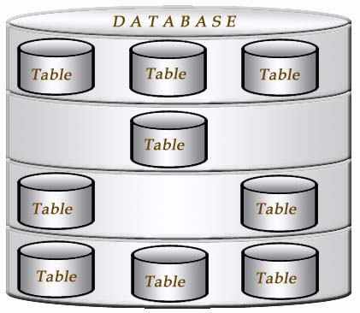
Solution : Internal
A site that allows employees to easily:
Add new events
Manage Event Registrations
A database that records all transactions and registrations

Slide 5
Solution : External
A site that allows customers to:
Search events
View upcoming events
Make payments
Register for events

Slide 6
Feature: Registering for an Event
Conditions
Member - limited personal information
Min: 1 vehicle in Garage
Search Functionality
Event Manifest
Payment - Paypal
Reason: Storage of Data

Slide 7
Feature: Accounts
Provides
Internal/External separation
Additional system abilities
How?
Hierarchical Account Structure
Separate data tables
Attribute for internal accounts
Visibility of views and options

Slide 8
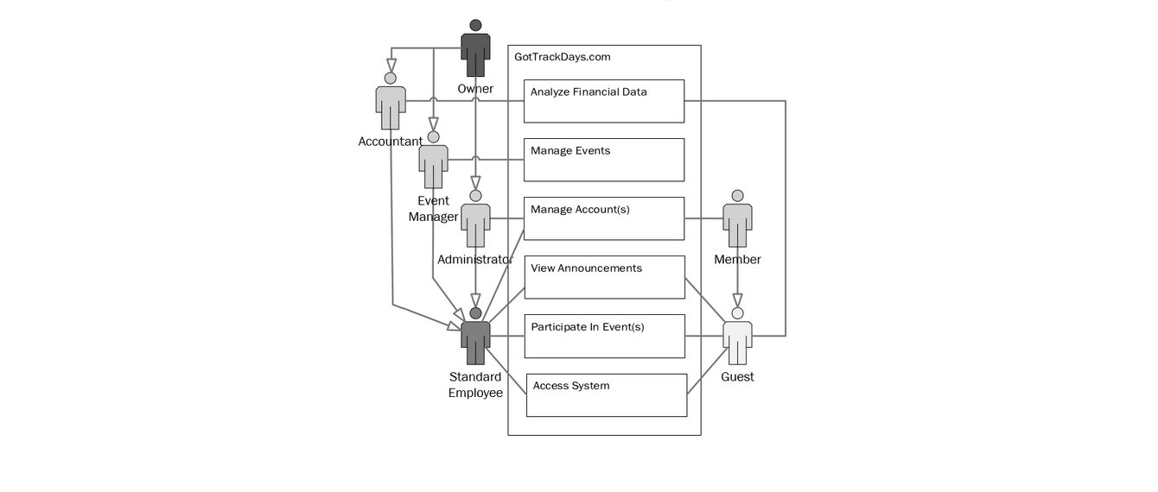
Account Types and Roles

Slide 9
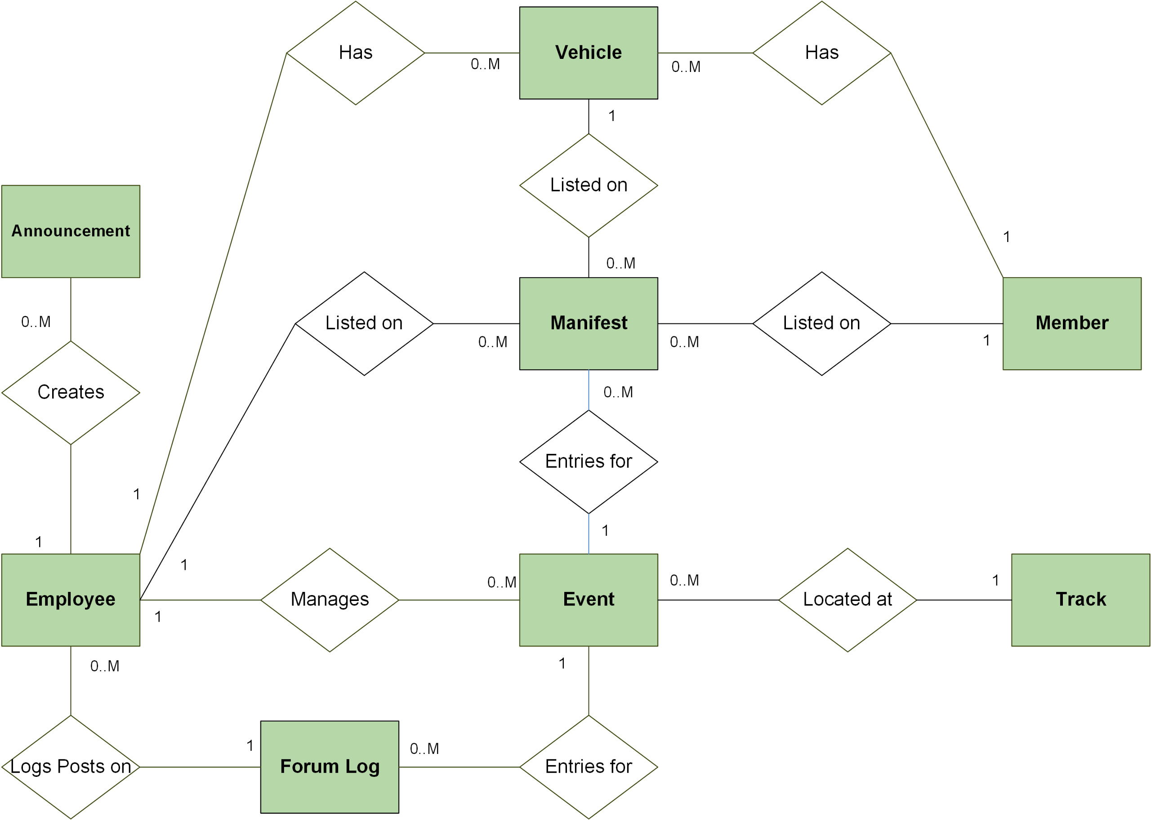
Information Model

Slide 10
Technical Skill/Learning Plan
Software Design
Modeling
SDS
Implementation
Web Application
Tech Stack?
MEAN
Testing
Strategy
Docs
STP
Tools

Slide 11
Risks
Scope of Project
Time Management
Web Design

Slide 12

Questions/Comments
Thank you!

